Slide 1



Presented by: Rita Arellano, Rebecca Nguyen, Marco Orozco
HomeRapport
Notes:
Home Rapport's mission is to help future property owners make wise decisions upon the purchase of a home. Our organization will deliver an App that can arm a potential home buyer with the proper tools before purchasing a property. Home Rapport’s App will grant users with valuable insider information from previous tenants, and neighbors about the property that may be available for sale or rent.

Slide 2
Ishikawa: Model
Management
Environment
Increasing HOA Fees
Cleanliness
Slow Response Time
Unsafe Environment
Too lenient
High Crime History
Homebuyer’s Remorse
Bad Tenants
Parking Issues
Animal Noise
High Traffic Volume
Rowdy Neighbors
Child-friendly
Misconception
Location
Notes:
Changes made: Updated defects and modified the end goal / Ishikawa Model helps an organization determine the root cause for a problem. It is used during the brainstorming process. In this diagram our group attempts to determine the root cause. We attempt to sort the reasons why a potential renter, or home buyer might experience renters/buyers remorse.

Slide 3
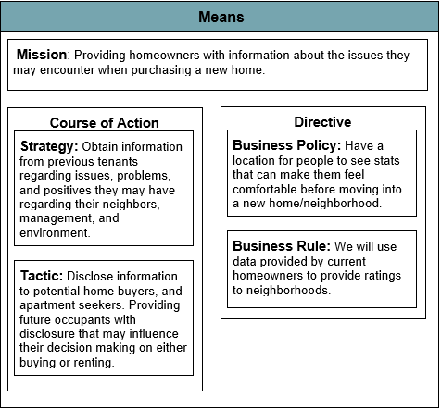
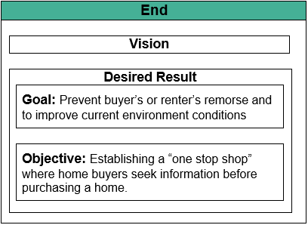
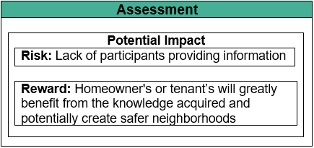
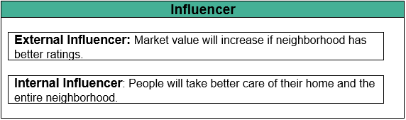
Business Motivation: Model (BMM)
Notes:
The Business Motivation Model (BMM) This diagram has an architecture that displays how our company plans to structure our mission and end goal. It contains our strategy, business policy, tactic and business rules. It contains our overall thought process on how to achieve our end goal, along with its side effects.

Slide 4
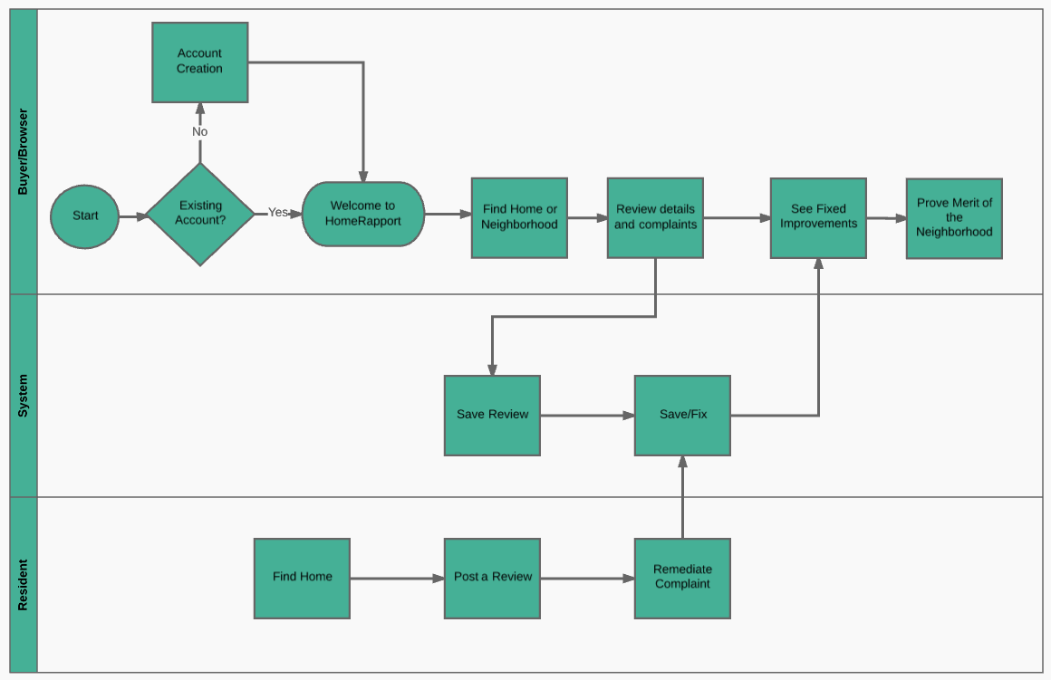
Business Process: Model and Notation (BPMN)
Notes:
Entities that are involved with the business process.
At first we only had the user and the resident.
After further feedback during our presentations we fixed several things and added another part to the BPMN, the System.

Slide 5
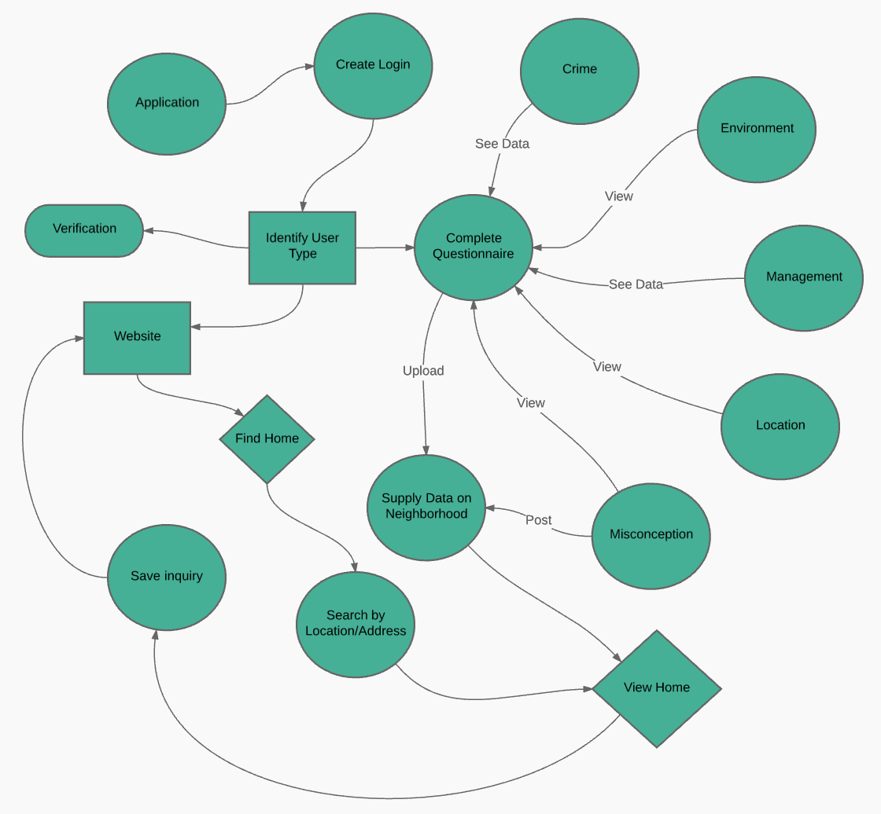
Business Process:
Data Flow diagram
Notes:
Business flow for frontend and backend processes
The user starts at the website/application to create a login. The system requests to identify the type of user. Once registered, the user can access the application and proceed to find a home/neighborhood or complete a questionnaire pertaining to the home/neighborhood. There will be questions regarding the crime rate, environment, management, and location. When users decide to review a home/neighborhood, they are able to either save their search to compare different searches, or start over.

Slide 6
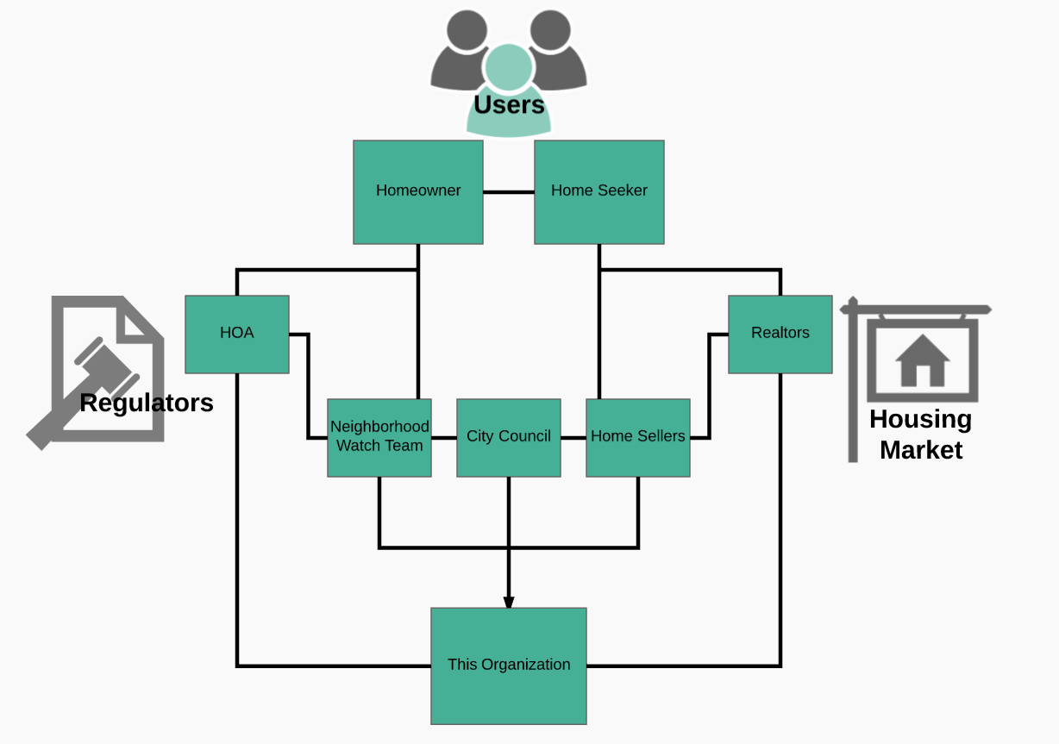
Organizational Chart
Notes:
We have three different organizations at play.
The Users, the Regulators and the Housing Market.
Each one then has different parts to them. For example, the Housing Market plays a role in our organization because
According to what the reviews are in a neighborhood, then the prices of the houses would fluctuate.

Slide 7
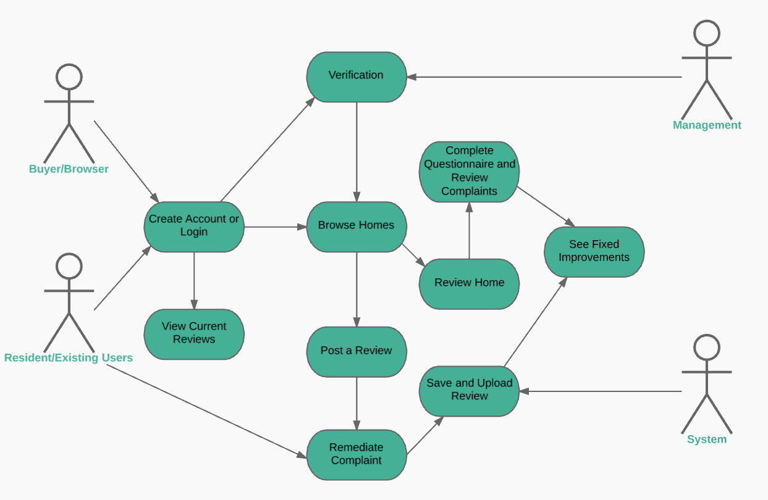
Use Case Diagram
Notes:
Use case diagram will show interaction with the user (actor). Case diagram displays how the use will use the app upon use. Statistics, Complaint Resolved, and write review are uses that the actor will utilize in order to get to rate their neighbor or neighborhood. There is also an option for recommendation, in where user can recommend their neighborhood/neighbor that extends the rate neighbor feature. Log in, Authentication, Search - are uses for Access information. Help, will assist user (actor) with any tech issue, or otherwise they may have, can access FAQ or be in contact with customer service rep.

Slide 8

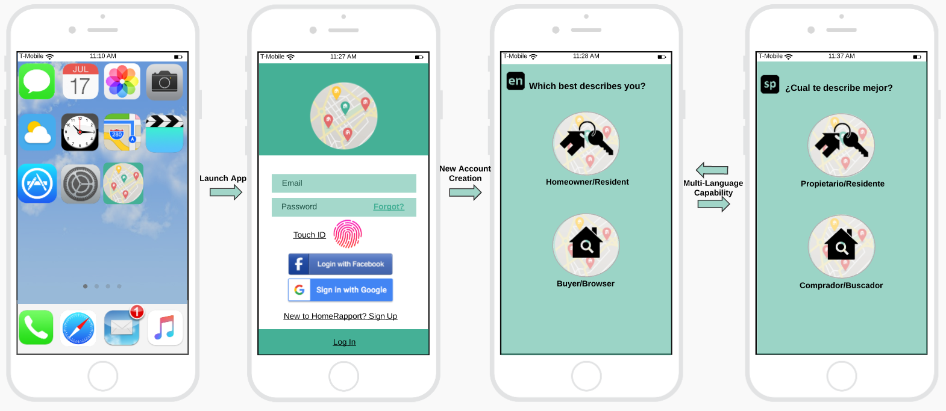
UI Wireframe Diagram
New User
Notes:
User interface/Initial interaction - new user. UI is the front-end application view to which user interacts in order to use our app. The first UI contains the initial view that our user will interact with. This slide depicts the UI at its initial interactions. 1.App - 2.Log in - Touch ID for easier access, or login with facebook or Google - 3.App will ask user if he/she is a renter, or owner - 4.App avail in other languages to reach a higher audience.

Slide 9
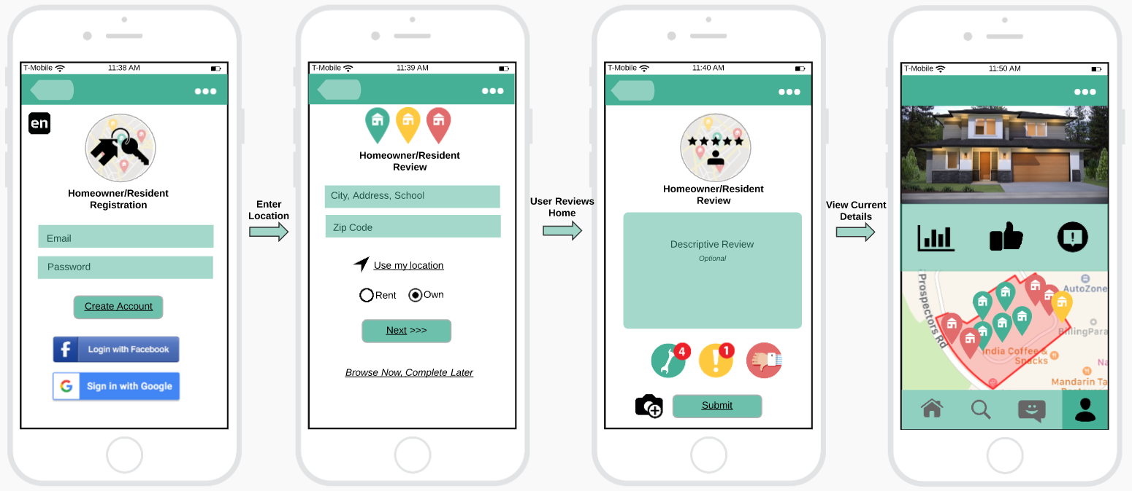
UI Wireframe Diagram
New Homeowner/Resident
Notes:
User Interface/Access property ratings - New Homeowner/Resident. *Once user has logged in for purposes of reviewing ratings, user can: 1. Enter the address in question - 2.He/She can then read review, or post a complaint / positive feedback. Property owner can also provide update’s of any issues that have been resolved.

Slide 10

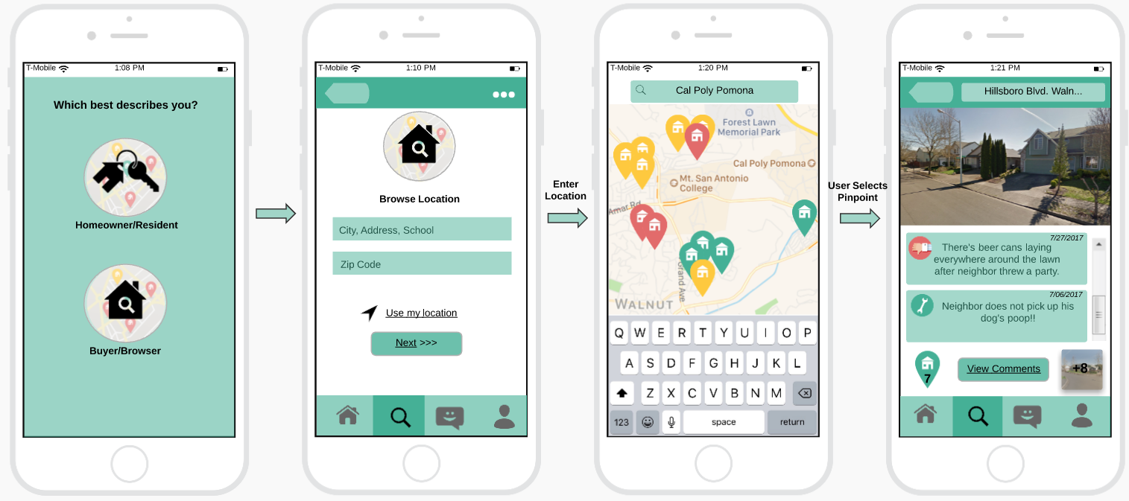
UI Wireframe Diagram
New Buyer/Browser
Notes:
User Interface/Select stance or browser - New Buyer/Browser. 1.User can select which best applies to his/her situation: buyer or renter - 2.Once user enters address, a map is provided - this feature allows for user to scout neighborhoods, and properties. 3. If a location is selected, immediate reviews of properties are available.

Slide 11

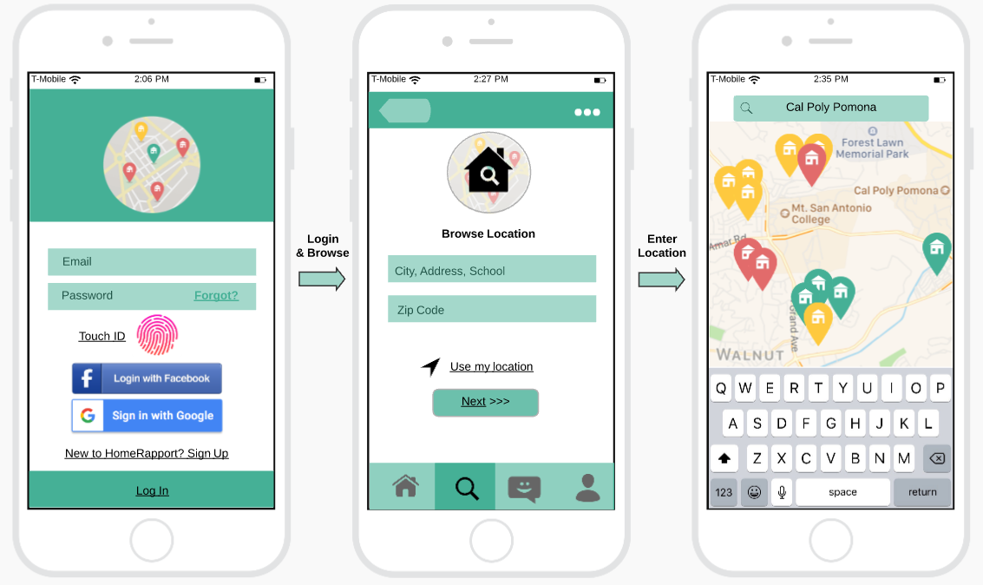
UI Wireframe Diagram
Existing User
Notes:
User Interface/ Existing User 1.Login 2. Enter address 3. Continue to scout properties, rate, and read reviews.

Slide 12
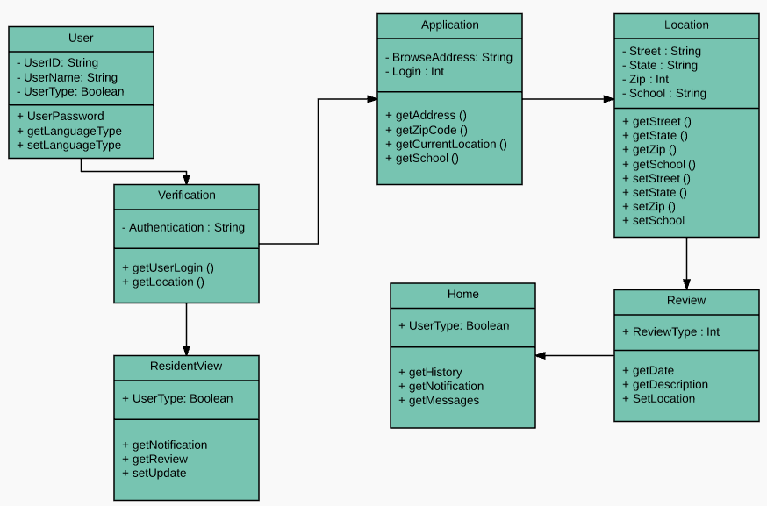
UML Diagram
Notes:
UML diagram displays in a hierarchical structure the interactions of our user with the app. It displays within a structure system behaviors and business processes.

Slide 13
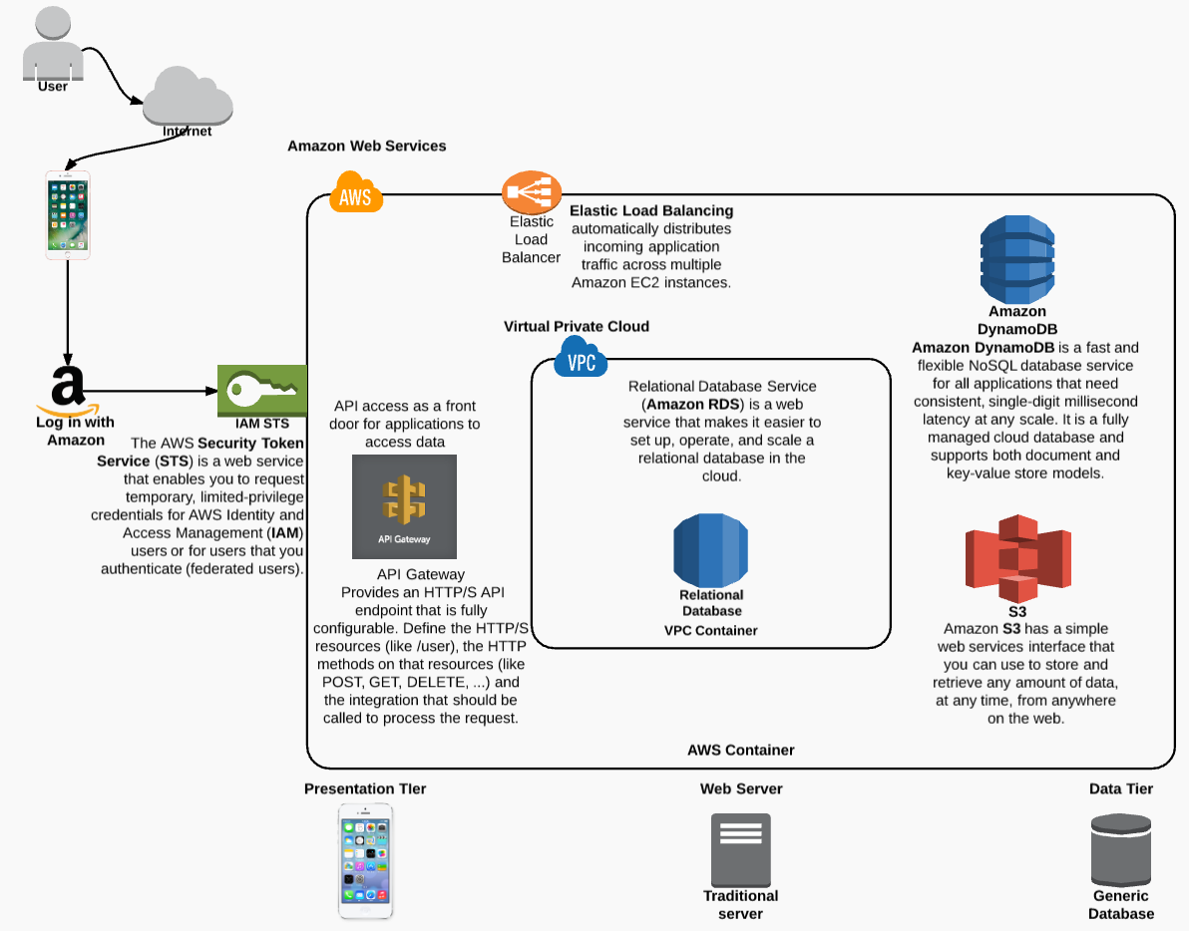
N-Tier Architecture with AWS
Notes:
N-Tier Architecture with AWS Amazon Virtual Private Cloud (Amazon VPC) enables one to launch Amazon Web Services into a virtual network. It works as a traditional network, with the benefits of using a scalable infrastructure provided by AWS. Above the steps are further depicted from start to finish.

Slide 14
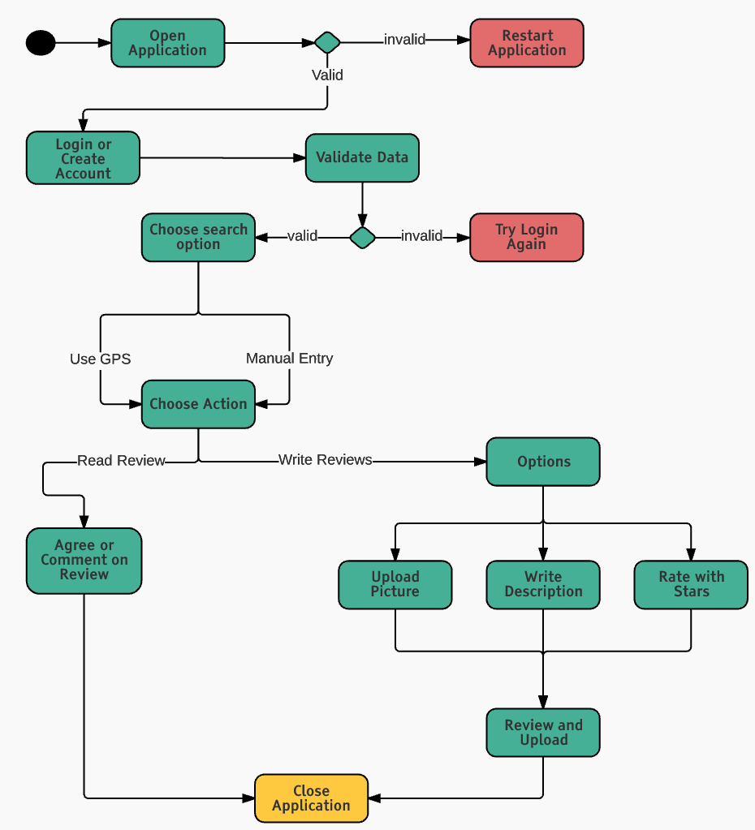
Activity Diagram
Notes:
Activity diagram is an important diagram in UML to describes the dynamic aspects of the system. Our activity diagram represents the flow from one activity to another activity. The activity describes the operation of our App.

Slide 15



Potential change of laws requiring people to take care of their neighborhoods
Company respects neutrality, legality, and ethics
P.E.S.T.L.E Analysis
Threat
External Impact
Opportunity
P
An increase in community and housing market
Companies that want to use our software will increase our growth potential
Greener lawns
Less waste in the streets.
E
E
Increase self awareness of community
People will care more about how they act around neighbors Target audience would be homeseekers regardless of class Create tension between neighbors
L
S
T
Regulations and Standards of Privacy
Hold people accountable for their community actions. Risk of users falsifying information
Easier interactions between communities to fix issues within a neighborhood
App is available to all platforms
Notes:
P.E.S.T.E.L analysis displays our organization's framework. We can utilize our PESTEL analysis as a marketing tool. It can help us analyse our threats, external impacts, and opportunities. P.E.S.T.E.L can help us examine our: political, economic, social, technological, environmental, and legal opportunities - all these factors have a great impact in our organization.

Slide 16
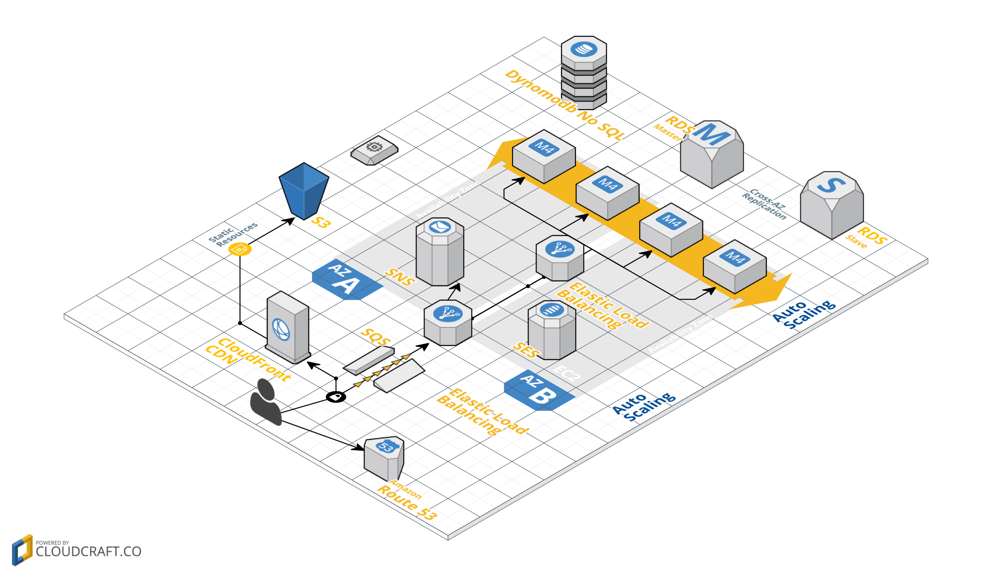
Notes:
SMTP/SES - Amazon SES sends email using the SMTP, the most common email protocol on the Internet. You can send email through Amazon SES by using a variety of SMTP-enabled programming languages and software to connect to the Amazon SES SMTP interface.
SNS -
SNS (Social network service) A social network service or social networking service, most often called SNS, is a medium for establishing social networks of people who share interests and/or activities. Social networking sites allow users to share ideas, activities, events, and interests within their individual networks.
SQS-
Amazon Simple Queue Service (Amazon SQS) is a scalable and fully managed message queuing service that allows users to transmit any amount of data through the web without administrative responsibility.
RDS-
Amazon Relational Database Service is a web service that makes it easy to set up, operate, and scale a relational database in the cloud. It provides cost-efficient and resizable capacity while managing time-consuming database administration tasks.
CLOUDFRONT - SPEEDS UP DISTRIBUTION
of your static and dynamic web content, such as .html, .css, .php, and image files, to your users. CloudFront delivers your content through a worldwide network of data centers called edge locations.
Elastic Load Balancing automatically distributes incoming application traffic across multiple Amazon EC2 instances. It enables you to achieve fault tolerance in your applications, seamlessly providing the required amount of load balancing capacity needed to route application traffic.
AWS Lambda. AWS Lambda is an event-driven, server less computing platform provided by Amazon as a part of the Amazon Web Services. It is a compute service that runs code in response to events and automatically manages the compute resources required by that code. It was introduced in 2014.

Slide 17
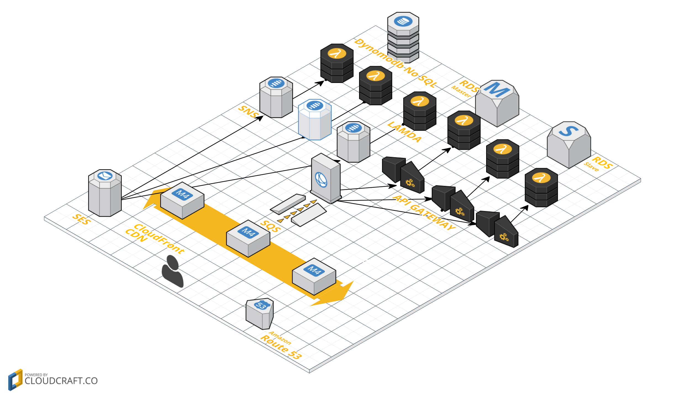
Notes:
SMTP/SES - Amazon SES sends email using the SMTP, the most common email protocol on the Internet. You can send email through Amazon SES by using a variety of SMTP-enabled programming languages and software to connect to the Amazon SES SMTP interface.
SNS -
SNS (Social network service) A social network service or social networking service, most often called SNS, is a medium for establishing social networks of people who share interests and/or activities. Social networking sites allow users to share ideas, activities, events, and interests within their individual networks.
SQS-
Amazon Simple Queue Service (Amazon SQS) is a scalable and fully managed message queuing service that allows users to transmit any amount of data through the web without administrative responsibility.
RDS-
Amazon Relational Database Service is a web service that makes it easy to set up, operate, and scale a relational database in the cloud. It provides cost-efficient and resizable capacity while managing time-consuming database administration tasks.
CLOUDFRONT - SPEEDS UP DISTRIBUTION
of your static and dynamic web content, such as .html, .css, .php, and image files, to your users. CloudFront delivers your content through a worldwide network of data centers called edge locations.
Elastic Load Balancing automatically distributes incoming application traffic across multiple Amazon EC2 instances. It enables you to achieve fault tolerance in your applications, seamlessly providing the required amount of load balancing capacity needed to route application traffic.
AWS Lambda. AWS Lambda is an event-driven, server less computing platform provided by Amazon as a part of the Amazon Web Services. It is a compute service that runs code in response to events and automatically manages the compute resources required by that code. It was introduced in 2014.

Slide 18
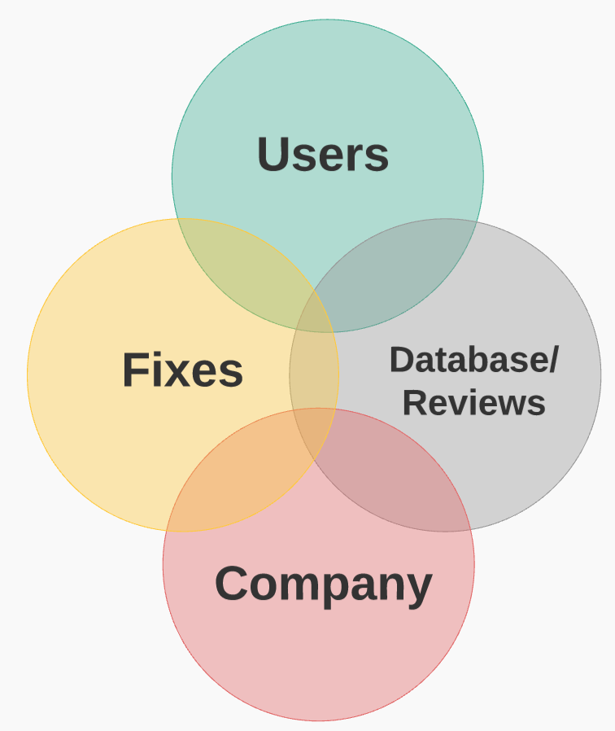
Venn Diagram
Customer Satisfaction
Notes:
Venn diagram shows all possible relations from our company, fixes, database reviews and users. All these relations overlap and combined allow for our users to experience customer satisfaction.

Slide 19


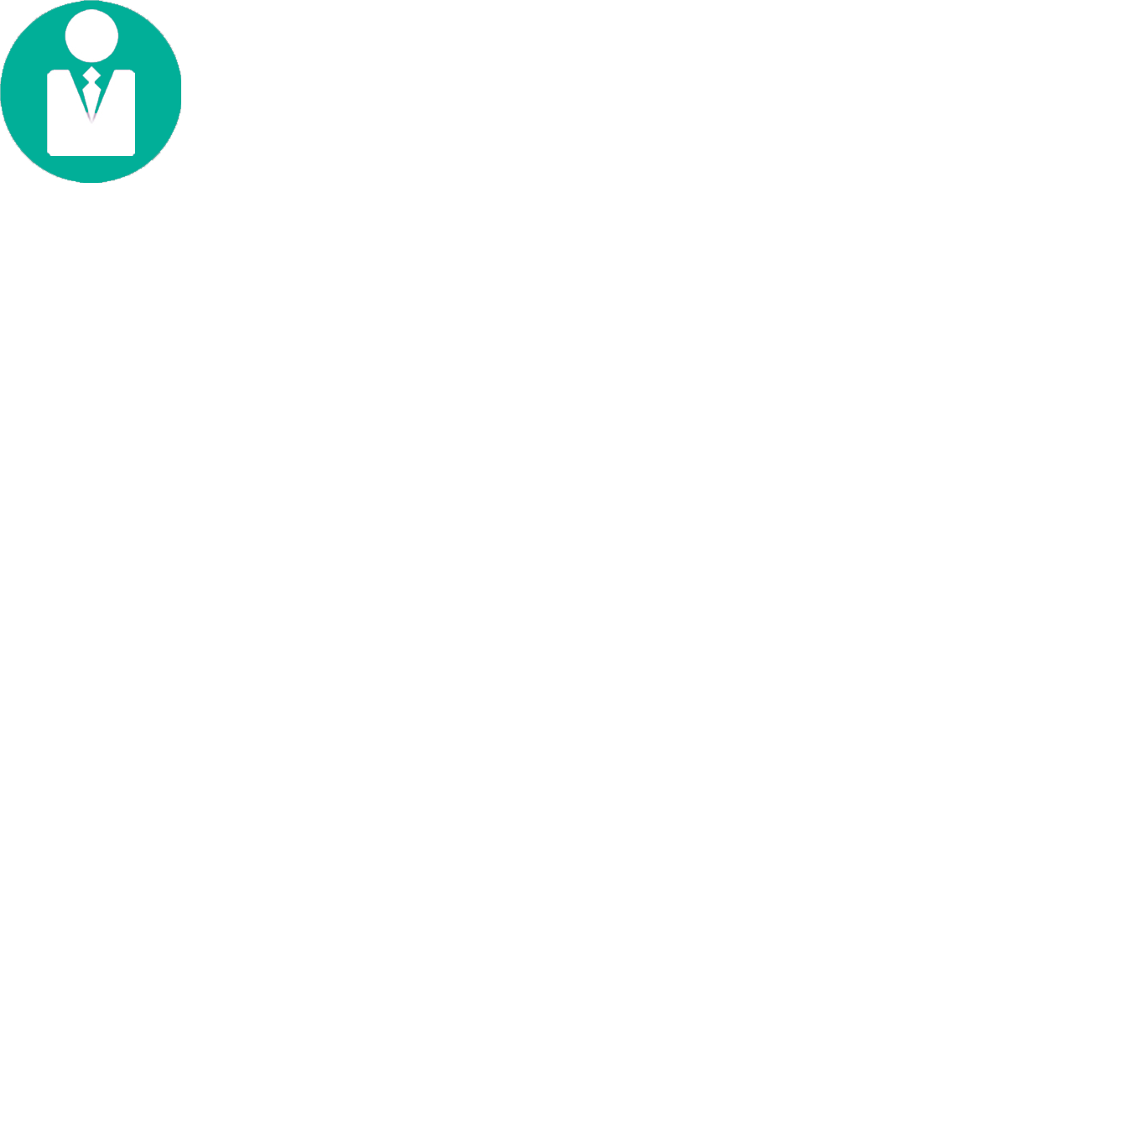


Porter’s Five Forces
Threat of New Entry
Competitive Rivalry
Product differentiation
Expensive development
Fast moving market
Services differentiation
Number of competitors
Competitive
Rivalry
Supplier Power
Buy Power
Uniqueness of service
Cost of creating new features and maintaining data
Number of users
Differences between competitors
Cost of creating new features and maintaining data
Threat of Substitution
Websites
Notes:
Porter's five forces analysis displays our framework for analyzing the level of competition within an our App industry. It also helps our organization develop a business strategy. Through this diagram we are able to analyze our rivals, examine new entrants, and analyze how much buying power our customers posses.

Slide 20
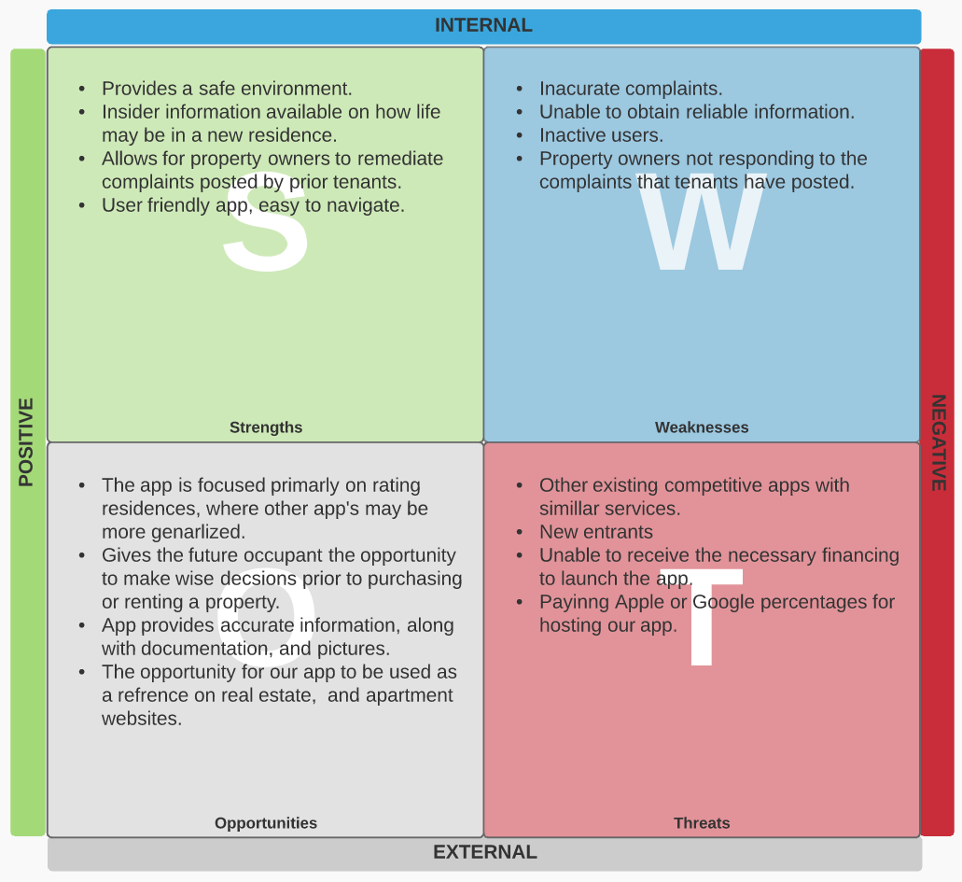
Notes:
S.W.O.T - . S.W.O.T can aid our company view our organization's current stance. It can help sort our strengths, weaknesses, opportunities, and threats with a realistic perspective.

Slide 21
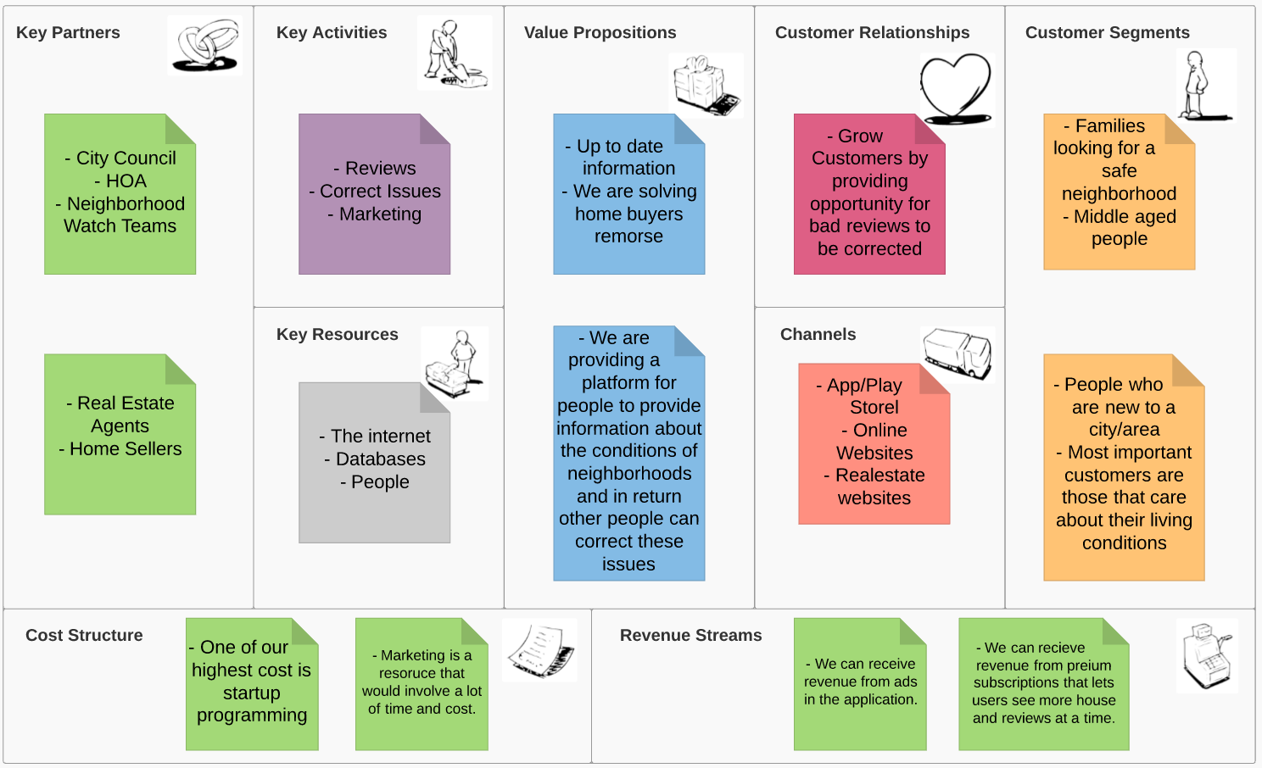
Business Model Canvas
Notes:
Business Model Canvas is a our strategic management startup template. It can assist our organization with developing, and keeping our presently used business models for documentation. It provides a visual chart with elements describing a our firm's product's value proposition, infrastructure, customers, and finances.

Slide 22
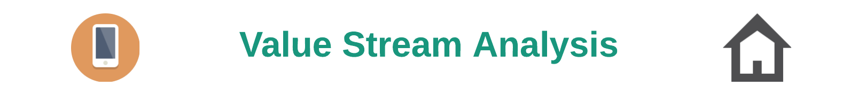
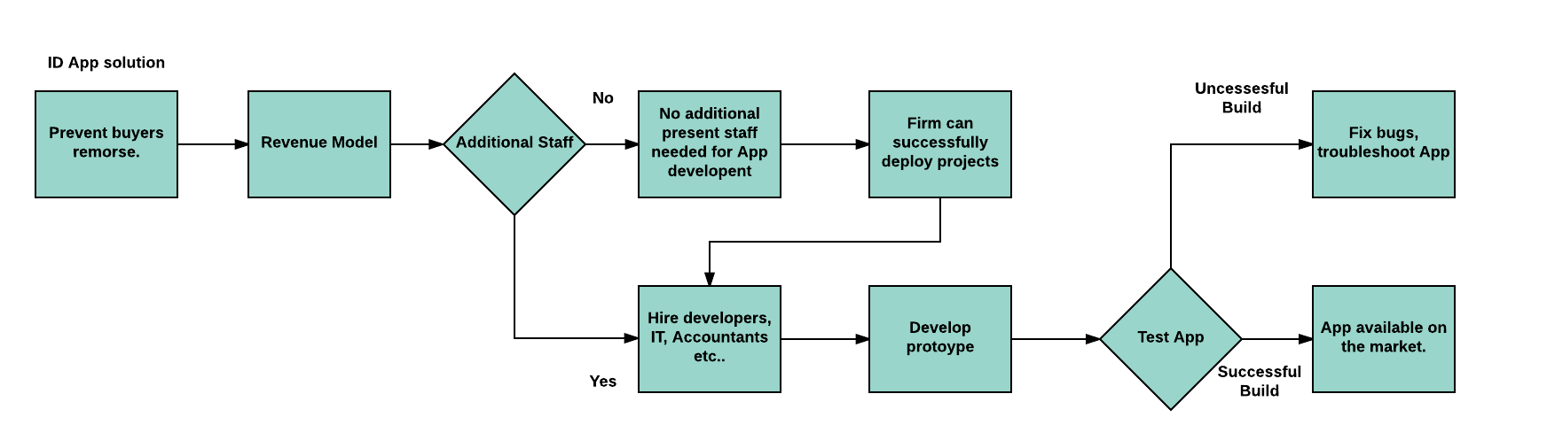
Notes:
Value stream will help our app come into fruition by mapping a lean method for analyzing our present state within our business organization.The structure of this diagram depicts the steps necessary to design our app and have it delivered to our customers.

